Slide 1
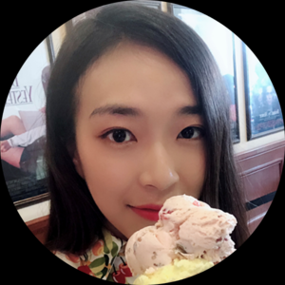




Implicit Saliency in Deep Neural Networks
Session : Learning-Based Models for Computational Imaging
Yutong Sun
Mohit Prabhushankar
Ghassan AlRegib
Codes
Website
Notes:
Hello. My name is Mohit Prabhushankar and this is our presentation about Implicit Saliency in Deep Neural Network. I thank the program and session chairs and all organizers who made this virtual conference possible.
In this paper we show that deep neural networks trained for a totally different task of classification has implicit saliency embedded within them. We extract this saliency based on the well studied expectancy-mismatch hypothesis. And we do all of this in a completely unsupervised fashion

Slide 2

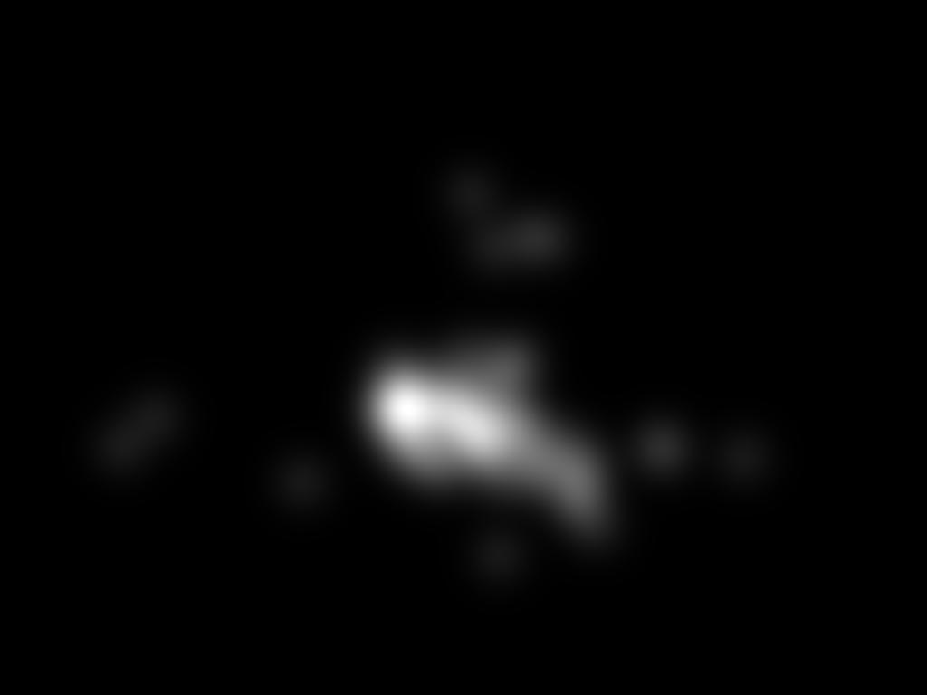
Saliency
Saliency is those regions in a visual scene that attract significant attention [1]
[1] Uddin, Lucina Q. Salience network of the human brain. Academic press, 2016.
Notes:
Saliency is those regions in a visual scene that attracts significant visual attention. Attention from human beings. Consider the shown image. This is taken from the popular MIT 1003 database. This image was shown to a number of people and their eyes were tracked. The grayscale map on the right is a combination of all their gazes. Notice that all the human subjects focused their attention on the people and horse in the scene.
Our goal is to objectively determine this grayscale map on the right.

Slide 3

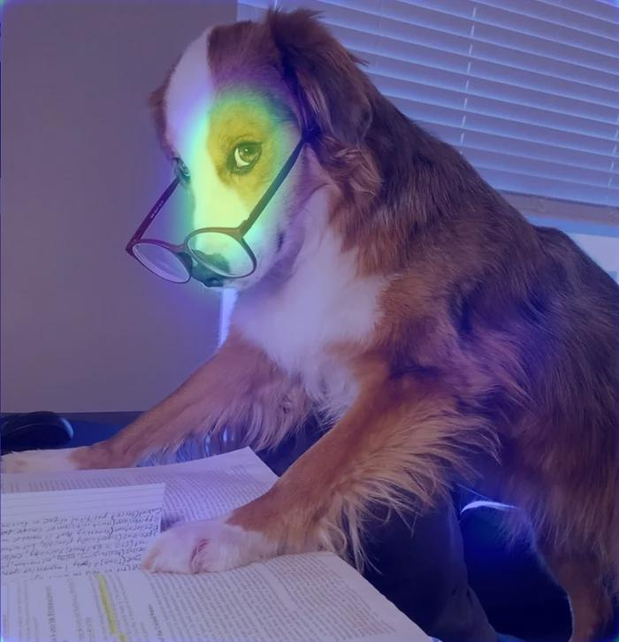
Saliency
General-purpose Saliency algorithm
Feature 1
Weights
Feature 2
Fusion
Feature 3
Weights
Bottom-Up Saliency : Innovation is in designing features and fusion
Top-Down Saliency : Innovation is in designing weights
Color, Intensity, Orientation [1]
Faces, text, object detectors [1]
[1] Judd, Tilke, Frédo Durand, and Antonio Torralba. "A benchmark of computational models of saliency to predict human fixations." (2012).
Notes:
Here we show a general purpose traditional saliency approach. Given an image, certain features that have neurologically shown to surprise and inform humans are considered. These are then weighted and fused to obtain the final saliency map. No doubt that the dog in glasses is both adorable and surprising which holds the attention of human – hence making it salient.
There are 2 broad approaches of innovating this pipeline - first one being design better features and fuse them. This is called Bottom-up saliency – a way of saying that saliency comes from the data itself and not the psyche of the individual looking at it. Color, intensity, orientation, and motion have been shown to effectively capture saliency. The other area is the top-down approach – where the weights of individual features can be set based on the task that the subject is asked to do. An example is the presence of text. Human beings are always drawn to text in a scene. Same thing with faces and objects – it holds the human attention. Generally top-down attention relates to the task that the subject wants to do.

Slide 4
Saliency
General-purpose Saliency algorithm
Feature 1
Weights
Feature 2
Fusion
Feature 3
Weights
Bottom-Up Saliency : Innovation is in designing features and fusion
Top-Down Saliency : Innovation is in designing weights
Color, Intensity, Orientation [1]
Faces, text, object detectors [1]
[1] Judd, Tilke, Frédo Durand, and Antonio Torralba. "A benchmark of computational models of saliency to predict human fixations." (2012).
Notes:
Digging deeper into bottom-up saliency,

Slide 5

Saliency Expectancy-Mismatch Hypothesis
General-purpose Saliency algorithm
Feature 1
Weights
Feature 2
Fusion
Feature 3
Weights
Bottom-Up Saliency : Innovation is in designing features and fusion
Top-Down Saliency : Innovation is in designing weights
Features that are new and unexpected in a scene are salient [1]
Color, Intensity, Orientation
Faces, text, object detectors [1]
[1] Becker, Stefanie I., and Gernot Horstmann. "Novelty and saliency in attentional capture by unannounced motion singletons."
Acta psychologica 136.3 (2011): 290-299.
Notes:
The design of feaures involves finding features that ‘measure’ new and unexpected regions in a scene.

Slide 6
Saliency Expectancy-Mismatch Hypothesis
General-purpose Saliency algorithm
Color
Weights
Intensity
Fusion
Orientation
Weights
Bottom-Up Saliency : Innovation is in designing features and fusion
Top-Down Saliency : Innovation is in designing weights
Color, intensity, and orientation : allow expectancy-mismatch to be measured
Features that are new and unexpected in a scene are salient [1]
Color, Intensity, Orientation
Faces, text, object detectors [1]
[1] Becker, Stefanie I., and Gernot Horstmann. "Novelty and saliency in attentional capture by unannounced motion singletons."
Acta psychologica 136.3 (2011): 290-299.
Notes:
Color, intensity and orientation do this job effectively because they allow expectancy-mismatch to be measured. Expectancy mismatch is a concept in cognitive science. It occurs when a system receives information that is in conflict with some prior expectation. A red apple in an image with a dark spot in its center stands out because of people’s expectation to see it all red. This mismatched dark spot grabs human attention and is hence salient.
Traditionally, expectancy-mismatch has been conducted on low-level features like color and edges.

Slide 7
Saliency Our Method
General-purpose Saliency algorithm
We introduce Expectancy – Mismatch for semantic information in a Top-Down setting
Color
Weights
Intensity
Fusion
Orientation
Weights
Bottom-Up Saliency : Innovation is in designing features and fusion
Top-Down Saliency : Innovation is in designing weights
Color, intensity, and orientation : allow expectancy-mismatch to be measured
Features that are new and unexpected in a scene are salient [1]
Color, Intensity, Orientation
Faces, text, object detectors [1]
[1] Becker, Stefanie I., and Gernot Horstmann. "Novelty and saliency in attentional capture by unannounced motion singletons."
Acta psychologica 136.3 (2011): 290-299.
Notes:
In this paper we introduce expectancy mismatch for semantic information in a top down setting. Lets first discuss what it means to have expectancy-mismatch in sematic content.

Slide 8
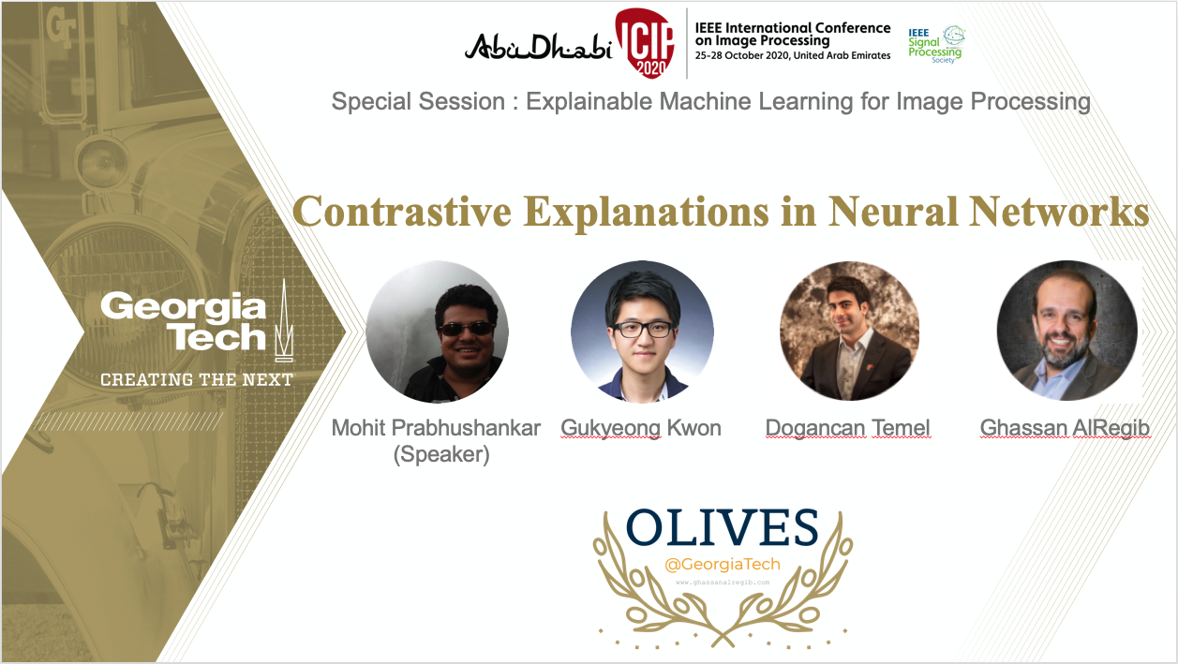
Top-Down Expectancy-Mismatch Motivation
What does Top-Down Expectancy-Mismatch give us?
Notes:
The motivation for semantic expectancy mismatch comes from a concurrent paper we have submitted here at ICIP – contrastive explanations in neural networks.

Slide 9

Top-Down Expectancy-Mismatch Motivation
What does Top-Down Expectancy-Mismatch give us?
ICIP Program details
Special session 13 : Explainable
Machine Learning in Image
Processing
Time : Wednesday, 28 October,
16:00 – 18:25
Concurrent submission at ICIP : Contrastive explanations in Neural Networks
Paper : https://arxiv.org/abs/2008.00178
Codes : https://github.com/olivesgatech/Contrastive-Explanations
Notes:
The details of its presentation is listed alongside along with all the relevant paper, website and code links.

Slide 10
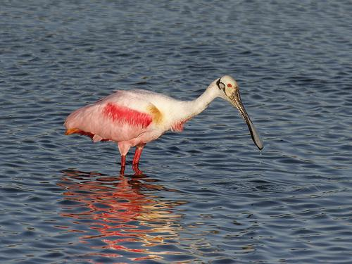
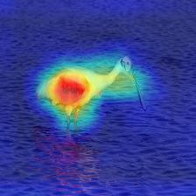
Top-Down Expectancy-Mismatch Motivation
What does Top-Down Expectancy-Mismatch give us?
ICIP Program details
Grad-CAM explanation
for the image
Special session 13 : Explainable
Machine Learning in Image
Processing
Time : Wednesday, 28 October,
16:00 – 18:25
Concurrent submission at ICIP : Contrastive explanations in Neural Networks
Paper : https://arxiv.org/abs/2008.00178
Codes : https://github.com/olivesgatech/Contrastive-Explanations
Notes:
Contrastive Explanations deal with providing explanations that are not causal. A state-of the art explanatory system for a classification network asks and answers the question of Why a Spoonbill is present in this image. Its visual answer is shown alongside.

Slide 11
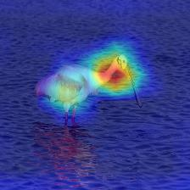
Top-Down Expectancy-Mismatch Motivation
What does Top-Down Expectancy-Mismatch give us?
ICIP Program details
Contrastive explanation
for `Why not Flamingo?’
Special session 13 : Explainable
Machine Learning in Image
Processing
Time : Wednesday, 28 October,
16:00 – 18:25
Expectancy-mismatch between Flamingo and Input
Concurrent submission at ICIP : Contrastive explanations in Neural Networks
Paper : https://arxiv.org/abs/2008.00178
Codes : https://github.com/olivesgatech/Contrastive-Explanations
Notes:
On the other hand contrastive explanations answer the question Why not flamingo. And from our method the network shows – its because there is no S shaped neck that is common to flamingos. An alternative way at looking at this the explanation on the right is that the network is telling us – ‘Hey, I was expecting an S shaped neck in the image. But it doesn’t exist. Hence not a flamingo’. The neck is the semantic information that did not match the expectancy of the network.

Slide 12
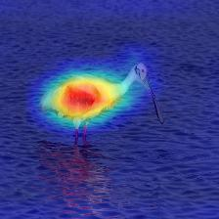
Top-Down Expectancy-Mismatch Motivation
What does Top-Down Expectancy-Mismatch give us?
ICIP Program details
Contrastive explanation
for `Why not Crane?’
Special session 13 : Explainable
Machine Learning in Image
Processing
Time : Wednesday, 28 October,
16:00 – 18:25
Expectancy-mismatch between Crane and Input
Concurrent submission at ICIP : Contrastive explanations in Neural Networks
Paper : https://arxiv.org/abs/2008.00178
Codes : https://github.com/olivesgatech/Contrastive-Explanations
Notes:
Similarly between the Spoonbill and crane, it’s the beak that did not match the expectancy of the network.

Slide 13
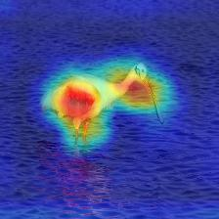
Top-Down Expectancy-Mismatch Motivation
What does Top-Down Expectancy-Mismatch give us?
ICIP Program details
Contrastive explanation
for `Why not Pig?’
Special session 13 : Explainable
Machine Learning in Image
Processing
Time : Wednesday, 28 October,
16:00 – 18:25
Expectancy-mismatch between Pig and Input
Concurrent submission at ICIP : Contrastive explanations in Neural Networks
Paper : https://arxiv.org/abs/2008.00178
Codes : https://github.com/olivesgatech/Contrastive-Explanations
Notes:
The legs and neck look nothing like that of a pig to the network.

Slide 14
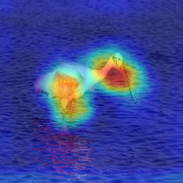
Top-Down Expectancy-Mismatch Motivation
What does Top-Down Expectancy-Mismatch give us?
ICIP Program details
Contrastive explanation
for `Why not Band-Aid?’
Special session 13 : Explainable
Machine Learning in Image
Processing
Time : Wednesday, 28 October,
16:00 – 18:25
Expectancy-mismatch between Band-Aid and Input
Concurrent submission at ICIP : Contrastive explanations in Neural Networks
Paper : https://arxiv.org/abs/2008.00178
Codes : https://github.com/olivesgatech/Contrastive-Explanations
Notes:
The same is the case with a band-aid.

Slide 15
Top-Down Expectancy-Mismatch Hypothesis
It gives us Expectancy-Mismatch in the semantic information within the input
Region to determine
`Why not Flamingo?’
Region to determine
`Why not Crane?’
Region to determine
`Why not Pig?’
Region to determine
`Why not Band-Aid?’
Combination of all possible Expectancy-Mismatch provides salient regions in image
Notes:
In short, we can obtain semantic information about visual scenes that do not match the expectation of networks.
This leads us to our hypothesis – combination of all expectancy-mismatch regions is the salient region in the image. For a bottom-up approach saliency is a processed expectancy-mismatch map. Stands to reason that for all possible and separate top-down based expectancy mismatch maps, their combination is saliency.

Slide 16
Top-Down Expectancy-Mismatch Challenge
It gives us Expectancy-Mismatch in the semantic information within the input
Region to determine
`Why not Flamingo?’
Region to determine
`Why not Crane?’
Region to determine
`Why not Pig?’
Region to determine
`Why not Band-Aid?’
Combination of all possible Expectancy-Mismatch provides salient regions in image
Notes:
Note that this leads us to our challenge – all possible maps

Slide 17
Top-Down Expectancy-Mismatch Challenge
It gives us Expectancy-Mismatch in the semantic information within the input
Region to determine
`Why not Flamingo?’
Region to determine
`Why not Crane?’
Region to determine
`Why not Pig?’
Region to determine
`Why not Band-Aid?’
Combination of all possible Expectancy-Mismatch provides salient regions in image
Region to determine `Why not Rattlesnake?’
Region to determine `Why not BlueJay?’
Region to determine `Why not Bulldog?’
.
.
Notes:
From the previous example it can lead to why not snake, or why not a bird or a dog and so on. This also raises the question of who sets the original expectancy for there to be a mismatch.

Slide 18
Paper Objective
It gives us Expectancy-Mismatch in the semantic information within the input
Obtain Expectancy of semantic information for an input
Extract all possible expectancy-mismatch in its sematic content
Combine expectancy-mismatch regions
Validate against saliency datasets
Region to determine
`Why not Flamingo?’
Region to determine
`Why not Crane?’
Region to determine
`Why not Pig?’
Region to determine
`Why not Band-Aid?’
Combination of all possible Expectancy-Mismatch provides salient regions in image
Region to determine `Why not Rattlesnake?’
Region to determine `Why not BlueJay?’
Region to determine `Why not Bulldog?’
.
.
Notes:
The objective of this paper is to tackle this challenge in a formal way. We first set expectancy of semantic content of an image. Then we provide a computationally feasible methodolgy to extract all possible expectancy-mismatch content before combining them all. Then we setup 3 experimental setups that answer the following – 1) semantic content is useful for saliency 2) Expectancy mismatch is better than expectancy and 3) Our unsupervised method is comparable to tranfer-learned methods that use deep learning and have trained on saliency and eye tracking data.

Slide 19
Paper Structure, Outcome, and Novelty
Objective :
Set semantic expectancy
Extract expectancy-mismatch
Combine mismatch maps
Experimental setup
Outcome :
Unsupervised saliency algorithms using pre-trained classification and detection networks
Novelty :
We extend the principle of expectancy-mismatch to semantic information in the input
We show that ImageNet trained classification networks have implicit saliency imbued within them
We obtain saliency of images from deep neural nets that have neither seen similar images nor trained to perform saliency detection
Notes:
The structure of the paper and rest of the video follows this objective. We set semantic expectancy and extract mismatch before combiinng them to validate on saliency. The outcome of this framework is an unsupervised saliency algorithm extracted from classification networks like ResNet, VGG and detection networks like Faster RCNN. These networks are trained on ImageNet and pascal VOC respectively and have never seen eye tracking data before. This is one of novelties of the proposed method the other being : 1) that we extend the principle of expectancy mismatch to semantic information in the input. And 2) Imagenet trained classification networks have embedded impliocit saliency – i.e to make their classification, they act as humans when looking at the most informative/surpring information in the scene.

Slide 20
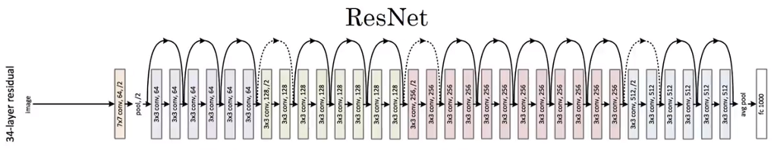
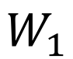
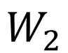


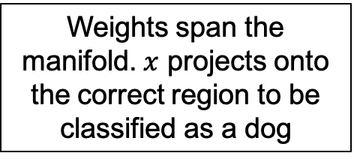
Semantic Expectancy and Implicit Saliency
Set semantic expectancy
Extract expectancy-mismatch
Combine mismatch maps
Experimental setup
We use neural networks to set expectancy
Dog
Input $x$
Higher layer indicates semantic content
Weights span the manifold. $x$ projects onto the correct region to be classified as a dog
$$W_{1}$$
$$W_{2}$$
$$x$$
The projection onto the span of learned weights is the expectancy
Notes:
Let us start by setting up expectancy.
We use imagenet pretrained deep neural networks to set expectancy.
Consider an input x. It is passed through a network which classifies x as a dog – correctly.
Note that within the network, the dog is projecting onto a manifold where its location is closer to the network’s expectancy of a what a dog is. The expectancy is the projection of data onto the weights an the manifold, Since network weights span the manifold, expectancy is defined as the projection onto the weights.
Note tthat higher the layer more is the semantic content.

Slide 21

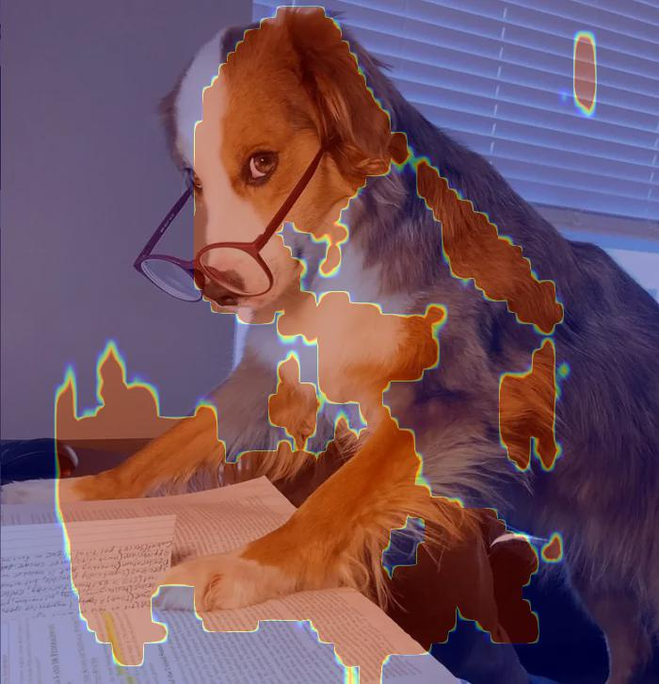
Semantic Expectancy and Implicit Saliency
Set semantic expectancy
Extract expectancy-mismatch
Combine mismatch maps
Experimental setup
We use neural networks to set expectancy
Dog
Input $x$
Neural networks have been trained to classify between 1000 classes – they have learned to do so by attending certain part of the image
The projection onto the span of learned weights is the expectancy
Notes:
Note that the network is trained to classify between 1000 classes within an image. Hence, they have to attend to the fine grained visual difference between classes and attend to these fine grained differences to make decisions.

Slide 22
Semantic Expectancy and Implicit Saliency
Set semantic expectancy
Extract expectancy-mismatch
Combine mismatch maps
Experimental setup
We use neural networks to set expectancy
Dog
Input $x$
Neural networks have been trained to classify between 1000 classes – they have learned to do so by attending certain part of the image
Implicit Saliency in Deep Neural Networks
The projection onto the span of learned weights is the expectancy
Notes:
Hence, there is an implicit saliency inbuilt within networks that we propose to extract.

Slide 23


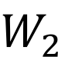
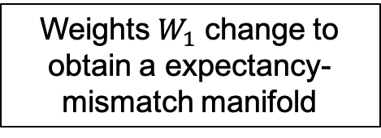

Expectancy-Mismatch
Set semantic expectancy
Extract expectancy-mismatch
Combine mismatch maps
Experimental setup
When a dog is classified as a cat : There is an expectancy-mismatch in its projection manifold
Weights $W_{1}$ change to obtain a expectancy-mismatch manifold
Dog classified as a cat
$$x$$
$$W_{1}$$
$$W_{2}$$
Weights span the manifold. $x$ projects onto the correct region to be classified as a dog
$$W_{1}$$
$$W_{2}$$
$$x$$
Dog classified as a dog
When a dog is classified as a dog : It is in its expected manifold
Notes:
Now to introduce mismatch to the expectancy.
Consider the previous case when the dog is projected onto the expected manifold.
Mismatch would happen if the dog is projected onto a manifold where it is classified as a cat – the same set of features leads to the classification of a cat rather than the correct dog.
Notice that such a change in manifold can occur if the the weights that span the manifold change – in this case W1.

Slide 24
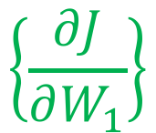
Expectancy-Mismatch
Set semantic expectancy
Extract expectancy-mismatch
Combine mismatch maps
Experimental setup
When a dog is classified as a cat : There is an expectancy-mismatch in its projection manifold
Weights $W_{1}$ change to obtain a expectancy-mismatch manifold
Dog classified as a cat
$$x$$
$$W_{1}$$
Gradients characterize the mismatch between manifolds
$$W_{2}$$
$$\left\{\frac{∂J}{∂W_{1}}\right\}$$
Weights span the manifold. $x$ projects onto the correct region to be classified as a dog
$$W_{1}$$
$$W_{2}$$
$$x$$
Dog classified as a dog
When a dog is classified as a dog : It is in its expected manifold
Notes:
This change or mismatch between the 2 manifolds is characterized by the gradients between them - dJ/dW1. This provides the direction of motion of mismatch

Slide 25
Expectancy-Mismatch
Set semantic expectancy
Extract expectancy-mismatch
Combine mismatch maps
Experimental setup
When a dog is classified as a cat : There is an expectancy-mismatch in its projection manifold
Weights $W_{1}$ change to obtain a expectancy-mismatch manifold
Dog classified as a cat
$$x$$
$$W_{1}$$
Projection on weights : Expectancy
Projection on gradients of weights : Expectancy-Mismatch
Gradients characterize the mismatch between manifolds
$$W_{2}$$
$$\left\{\frac{∂J}{∂W_{1}}\right\}$$
Weights span the manifold. $x$ projects onto the correct region to be classified as a dog
$$W_{1}$$
$$W_{2}$$
$$x$$
Dog classified as a dog
When a dog is classified as a dog : It is in its expected manifold
Notes:
Projection onto these gradients is expectancy mismatch. Note that the mismatch manifold is spanned by the gradients of weights while the expectancy manifold is the weights themselves - providing a nice symmetry to the whole space spanned by the network.

Slide 26
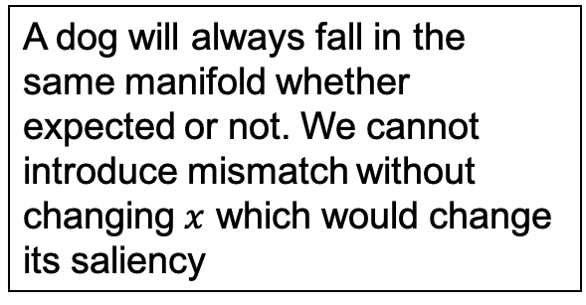
Expectancy-Mismatch
Set semantic expectancy
Extract expectancy-mismatch
Combine mismatch maps
Experimental setup
Top-Down Approach
Dog classified as a cat
$$x$$
We backpropagate the wrong class
Bottom-Up Approach
$$W_{1}$$
A dog will always fall in the same manifold whether expected or not. We cannot introduce mismatch without changing $x$ which would change its saliency
$$W_{2}$$
$$W_{1}$$
$$W_{2}$$
$$x$$
Dog classified as a dog
Notes:
Going back to our earlier discussion of top-down vs bottom up, we can finally see why the proposed method is expectancy mismatch based on top-down characteristics
From a bottom up approach, the only way a dog projects onto the wrong manifold id when it is projected incorrectly – i.e the expectation is itself incorrect. Hence the salient region it is examining to make its decision is incorrect thereby leading to the conclusion that its implicit saliency is itself incorrect.
On the other hand, expectancy mismatch can be introduced by backpropagating the wrong class. Even if the original expectancy is wrong, we are looking at its mismatch against another class which still provides some information about the semantic mismatch that drives our proposed method.

Slide 27
Implicit Saliency in Deep Neural Networks
Session : Learning-Based Models for Computational Imaging
Yutong Sun
Mohit Prabhushankar
Ghassan AlRegib
Codes
Website
Notes:
I now hand over the reins to my co-author Yutong to bring this home.
Yutong:
Thanks Mohit. I will go through the block diagram and methodology of extracting expectancy mismatch maps before talking about our results.

Slide 28
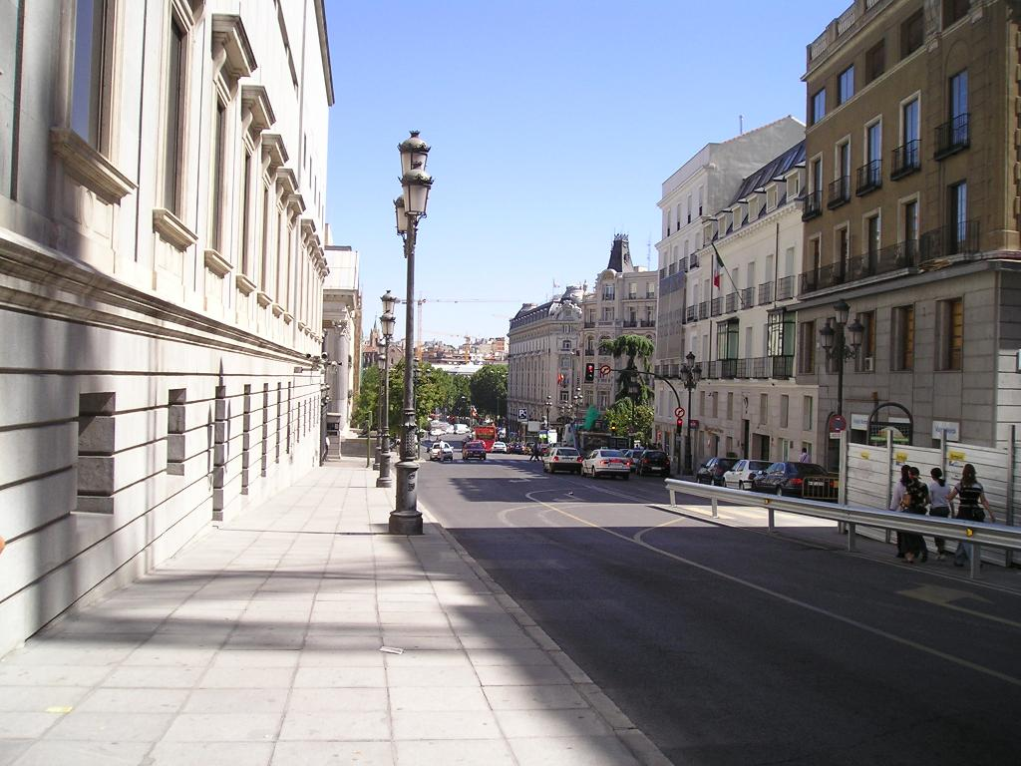
Expectancy-Mismatch
Feed-Forward Process
Set semantic expectancy
Extract expectancy-mismatch
Combine mismatch maps
Experimental setup
layer l
Convolution and Pooling Layers
Input
Image
Notes:
Consider an input image that is passed through a CNN. This image is from MIT 1003 database.

Slide 29
Expectancy-Mismatch
Feed-Forward Process
Set semantic expectancy
Extract expectancy-mismatch
Combine mismatch maps
Experimental setup
Back-
graound
Airplane
Car
This is a Car
...
Prediction
layer l
Convolution and Pooling Layers
Input
Image
Notes:
After the feed-forward process, the CNN will give a prediction. In this case, the network says that the image is that of a car.

Slide 30
Expectancy-Mismatch
Feed-Forward Process
Set semantic expectancy
Extract expectancy-mismatch
Combine mismatch maps
Experimental setup
Back-
graound
Unexpected stimuli
Airplane
Car
...
Prediction
layer l
Convolution and Pooling Layers
Input
Image
Notes:
Then we provide the unexpected mismatch from outside the CNN

Slide 31
Expectancy-Mismatch
Feed-Forward Process
Set semantic expectancy
Extract expectancy-mismatch
Combine mismatch maps
Experimental setup
Back-
graound
Unexpected stimuli
This is a Car
Prediction Error Encoding
(Loss Function)
Airplane
Car
...
Prediction
layer l
Convolution and Pooling Layers
Input
Image
Notes:
There will be an expectancy-mismatch between the prediction and the unexpected stimuli. And we encode this mismatch using a loss function. Each unexpected stimulus can generate an gradient map on layer l, which is the pseudo saliency map

Slide 32
Expectancy-Mismatch
Feed-Forward Process
Set semantic expectancy
Extract expectancy-mismatch
Combine mismatch maps
Experimental setup
Back-
graound
Unexpected stimuli
This is a Car
Prediction Error Encoding
(Loss Function)
This is background
Airplane
Car
...
Prediction
layer l
Convolution and Pooling Layers
Input
Image
Notes:
We then introduce an unexpected mismatch or stimuli from outside the CNN. There will be an expectancy-mismatch between the prediction and the unexpected stimuli. And we encode this mismatch using a loss function. Each unexpected stimulus can generate a gradient map on layer l, which we will call the pseudo saliency map
For instance, first we give the unexpected stimulus 'This is background'.

Slide 33
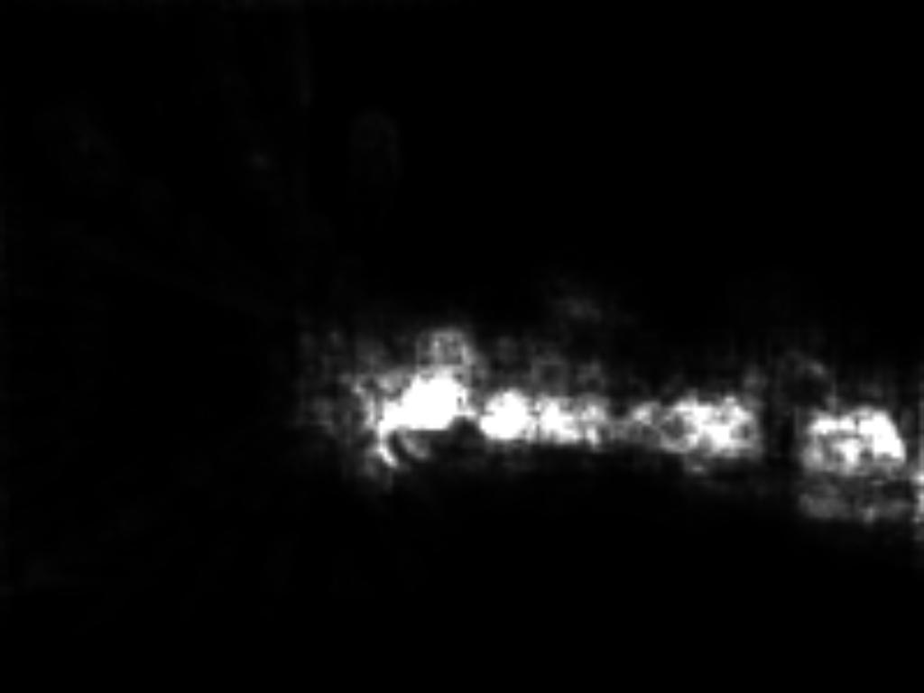
Expectancy-Mismatch
Feed-Forward Process
Set semantic expectancy
Extract expectancy-mismatch
Combine mismatch maps
Experimental setup
Back-
graound
Unexpected stimuli
This is a Car
Prediction Error Encoding
(Loss Function)
This is background
Airplane
Car
...
Prediction
Gradients
layer l
Convolution and Pooling Layers
Pseudo
Saliency
Maps
Background
Input
Image
Notes:
With the prediction 'This is a car' and the unexpected stimulus 'This is background', we loss encoded prediction error is backpropagated to some layer l within the CNN. Thus we get the pseudo saliency map corresponding to the stimulus 'This is background '

Slide 34
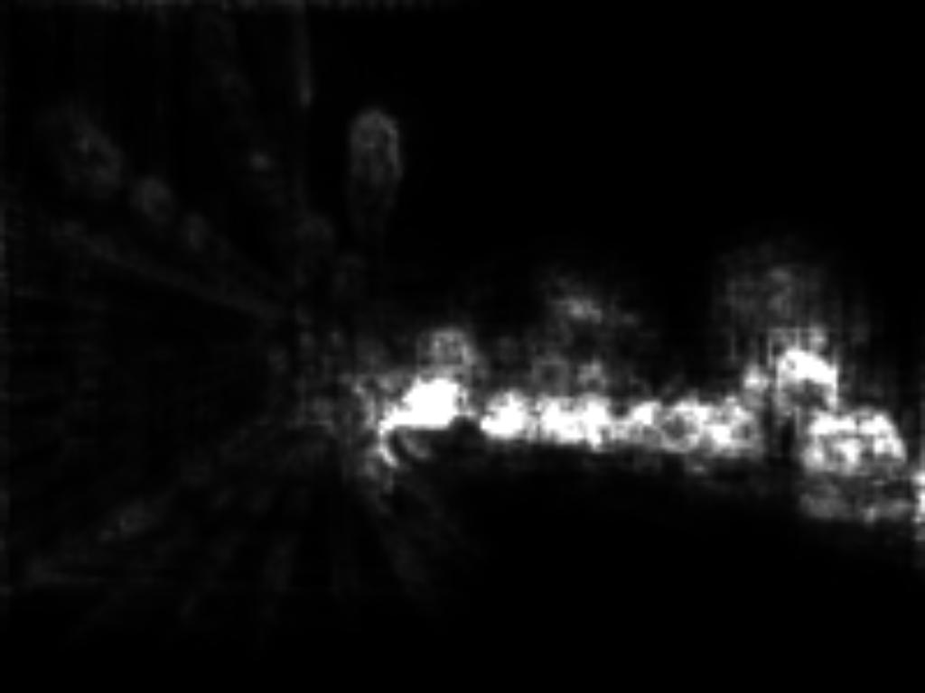
Expectancy-Mismatch
Feed-Forward Process
Set semantic expectancy
Extract expectancy-mismatch
Combine mismatch maps
Experimental setup
Back-
graound
Unexpected stimuli
This is a Car
Prediction Error Encoding
(Loss Function)
This is background
Airplane
Car
...
This is an airpane
Prediction
Gradients
layer l
Convolution and Pooling Layers
Pseudo
Saliency
Maps
Background
Airplane
Input
Image
Notes:
Same with the stimulus 'This is an airplane'. we can get a psesudo saliency map corresponding to the airplane stimulus

Slide 35
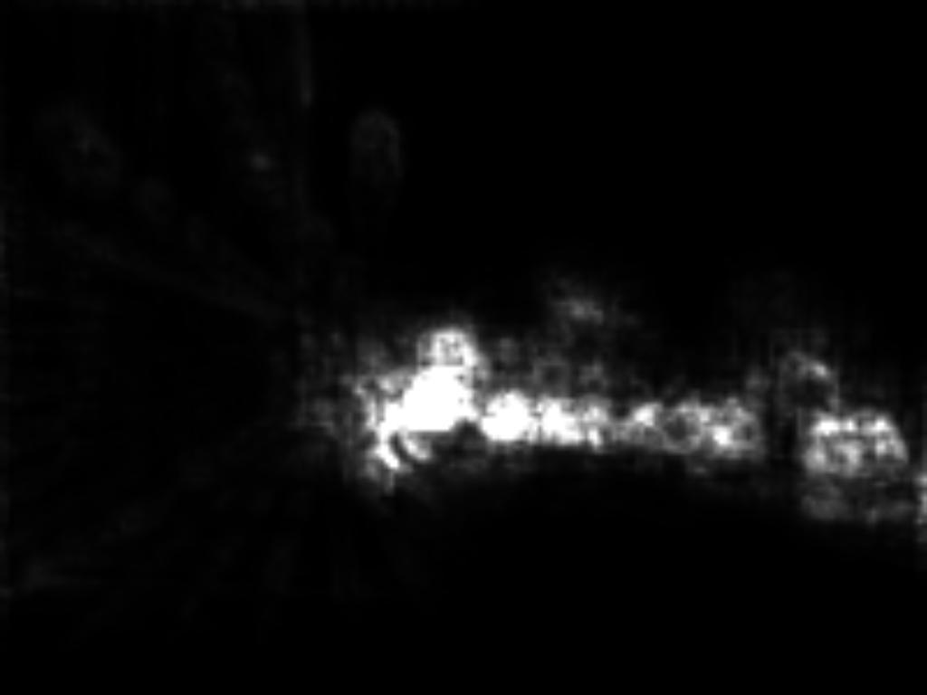
Expectancy-Mismatch
Feed-Forward Process
Set semantic expectancy
Extract expectancy-mismatch
Combine mismatch maps
Experimental setup
Back-
graound
Unexpected stimuli
This is a Car
Prediction Error Encoding
(Loss Function)
This is background
Airplane
Car
...
This is an airpane
Prediction
. . .
...
Gradients
This is a car
layer l
Convolution and Pooling Layers
. . .
Pseudo
Saliency
Maps
Background
Airplane
Car
Input
Image
Notes:
Similarly, we can extract pseudo saliency maps or expectancy mimatch maps for all possible stimuli until the last one – This is a car.

Slide 36
Expectancy-Mismatch
Feed-Forward Process
Set semantic expectancy
Extract expectancy-mismatch
Combine mismatch maps
Experimental setup
Back-
graound
Unexpected stimuli
This is a Car
Prediction Error Encoding
(Loss Function)
This is background
Airplane
Car
...
This is an airpane
Prediction
. . .
...
Gradients
This is a car
layer l
Convolution and Pooling Layers
. . .
Pseudo
Saliency
Maps
Background
Airplane
Car
Input
Image
1000 possible pseudo-saliency maps for classification networks or 21 maps for detection networks
Notes:
After generating pseudo saliency map for all possible classes, we use statistical strategies to generate the final saliency map.

Slide 37
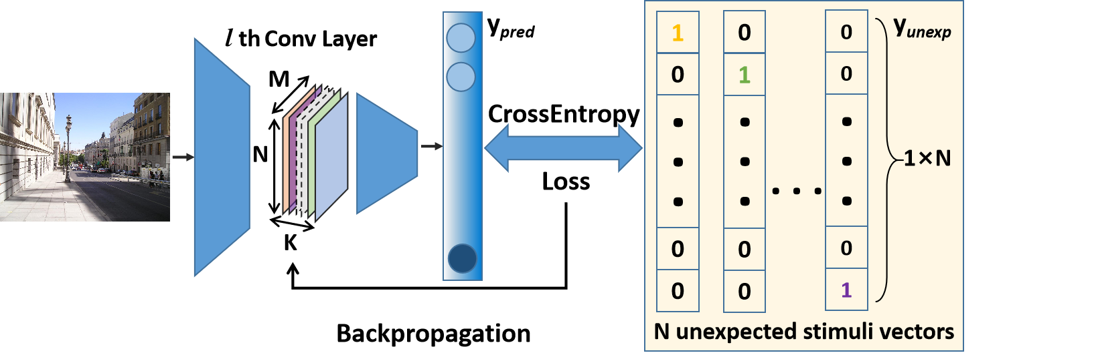
Combining Pseudo-Saliency Maps
Set semantic expectancy
Extract expectancy-mismatch
Combine mismatch maps
Experimental setup
1
0
0
0
y_{unexp}
0
1
0
0
...
...
...
...
...
1×R
0
0
1
0
0
0
0
1
R unexpected stimuli vectors
...
R Pseudo
Saliency
Maps
Notes:
Specifically, the unexpected stimuli are 1×R onehot vectors, R is the number of classes in the model. pseudo saliency maps are M×N×K matrices based on the size of layer l.

Slide 38
Combining Pseudo-Saliency Maps
Set semantic expectancy
Extract expectancy-mismatch
Combine mismatch maps
Experimental setup
1
0
0
0
y_{unexp}
0
1
0
0
...
...
...
...
...
1×R
0
0
1
0
0
0
0
1
R unexpected stimuli vectors
Mean
of the R Pseudo Saliency Maps
...
R Pseudo
Saliency
Maps
Variance
of the R Pseudo Saliency Maps
Notes:
We calculate the mean and variance of the R pseudo saliency maps

Slide 39
Combining Pseudo-Saliency Maps
Set semantic expectancy
Extract expectancy-mismatch
Combine mismatch maps
Experimental setup
1
0
0
0
y_{unexp}
0
1
0
0
...
...
...
...
...
1×R
0
0
1
0
0
0
0
1
R unexpected stimuli vectors
Mean
of the R Pseudo Saliency Maps
...
R Pseudo
Saliency
Maps
Pixel-wise Multiplication
Variance
of the R Pseudo Saliency Maps
Notes:
And combine them using pixel wise multiplication. This is to keep the most reccuring patterns within the channels of the maps among all maps.

Slide 40
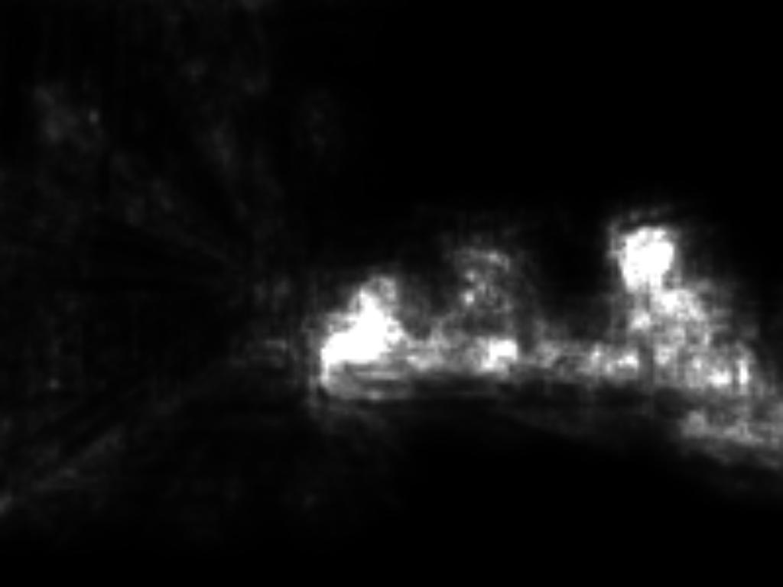
Combining Pseudo-Saliency Maps
Set semantic expectancy
Extract expectancy-mismatch
Combine mismatch maps
Experimental setup
1
0
0
0
y_{unexp}
0
1
0
0
...
...
...
...
...
1×R
0
0
1
0
0
0
0
1
R unexpected stimuli vectors
Mean
of the R Pseudo Saliency Maps
...
R Pseudo
Saliency
Maps
Pixel-wise Multiplication
Variance
of the R Pseudo Saliency Maps
Notes:
The pixel wise multiplication yields the final saliency map.

Slide 41
Combining Pseudo-Saliency Maps
Set semantic expectancy
Extract expectancy-mismatch
Combine mismatch maps
Experimental setup
Implicit Saliency Generation
y_{unexp}
1
0
0
0
0
1
0
0
...
...
...
...
...
1×R
0
0
1
0
0
0
0
1
R unexpected stimuli vectors
Mean
of the R Pseudo Saliency Maps
...
R Pseudo
Saliency
Maps
Pixel-wise Multiplication
Variance
of the R Pseudo Saliency Maps
Notes:
This is our Implicit Saliency generation methodology.

Slide 42
Experimental Goals
Set semantic expectancy
Extract expectancy-mismatch
Combine mismatch maps
Experimental setup
To show :
Expectation-Mismatch saliency is correlated with human attention more than its Expectation counterpart.
Implicit Saliency is greater than model saliency
Compare performance of proposed unsupervised Implicit Saliency model against existing saliency model
Notes:
We now discuss the experimental validity of our proposed saliency algorithm.
Along the way we have made several claims : 1) That expectancy mismatch saliency is more attuned to human visual saliency than expectation saliency. 2) That our implicit saliency is better than model saliency on HVS eye tracking data. 3) Our unsupervised algorithm holds its own against existing saliency models trained on eye tracking data.

Slide 43
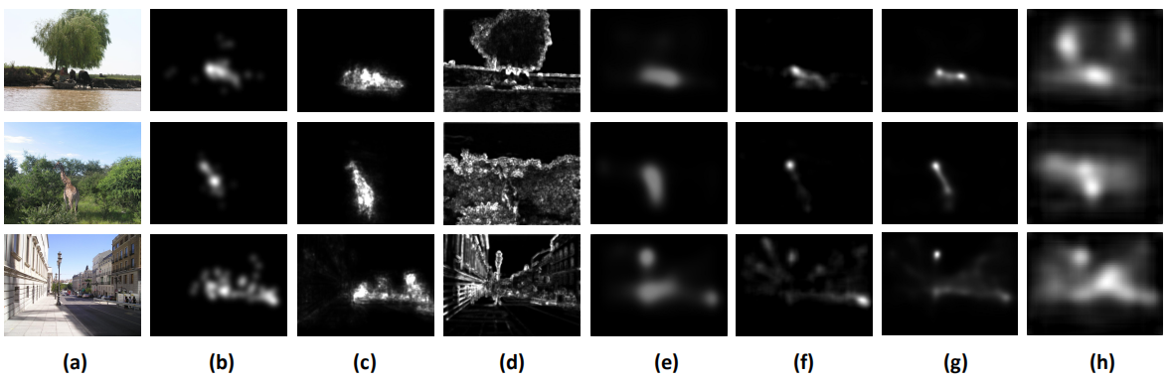
Experiments
Set semantic expectancy
Extract expectancy-mismatch
Combine mismatch maps
Experimental setup
Expectation-Mismatch saliency is correlated with human attention more than its Expectation counterpart
Expectation features:
Edges and textures
Without specific localization
Proposed expectation-mismatch Saliency:
Localized saliency maps
Highly correlated with ground truth
Input Image
Groundtruth
Proposed Method
Expectancy
Notes:
We first compare the performance of normal expectancy saliency and expectation mismatch saliency. For the expectancy, we take the activation – or the projection on weights - in the CNN and use the same statistical strategy to get the saliency map. Some qualitative results are shown here. From the visualizations we can see that the expectancy or activation features focus on edges and textures without specific localization. The proposed implicit saliency generates localized saliency maps which are highly correlated with the ground truth.

Slide 44
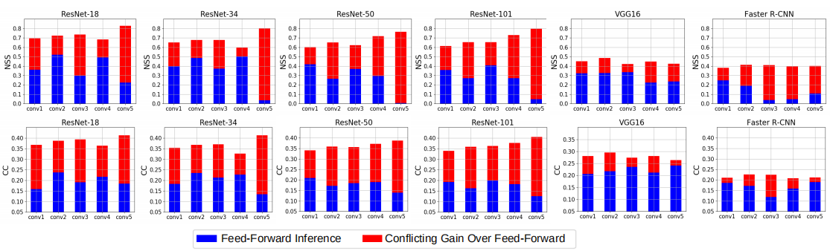
Experiments
Set semantic expectancy
Extract expectancy-mismatch
Combine mismatch maps
Experimental setup
Expectation-Mismatch saliency is greater than Expectation saliency in semantic information
Feed-forward expectation features:
Edges and textures
Without specific localization
Proposed expectation-mismatch Saliency:
Localized saliency maps
Highly correlated with ground truth
Input Image
Groundtruth
Proposed Method
Feed-forward feature
Notes:
We show quantitative results on MIT 1003 database. We apply two evaluation metrics for six different networks. Blue bars represent the expectancy feature performance and red bars represent proposed method’s gain. The performances of all networks over all layers imporve.
Also. if we look at the bars inside the dark blue boxes, blue bars can drop sharply from one layer to the next and the red bars shows a more robust performance. These results show that the visual saliency is more effectively captured through the expectancy-mismatch process compared against expectancy process of common classification and detection networks. Note that all classification networks are trained on ImageNet and Faster RCNN is trained on Pascal VOC.

Slide 45
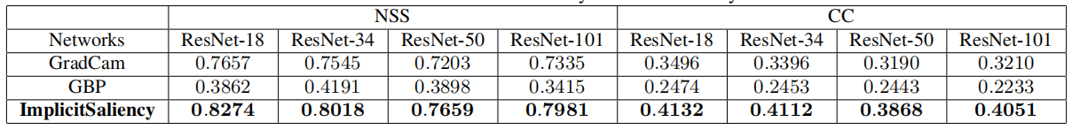
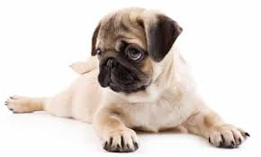
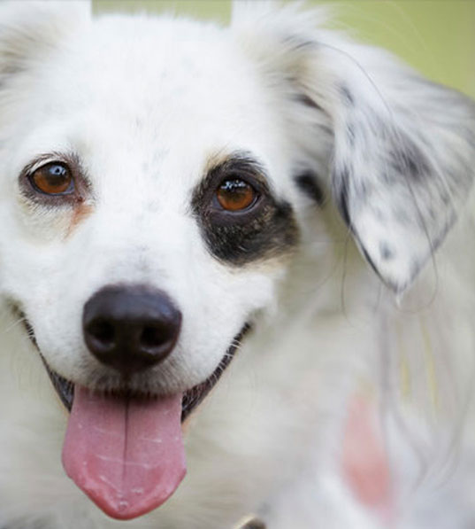
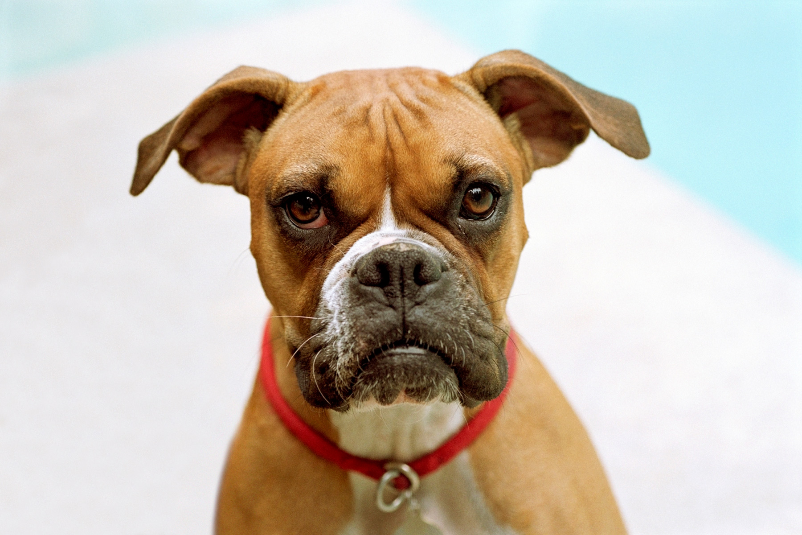
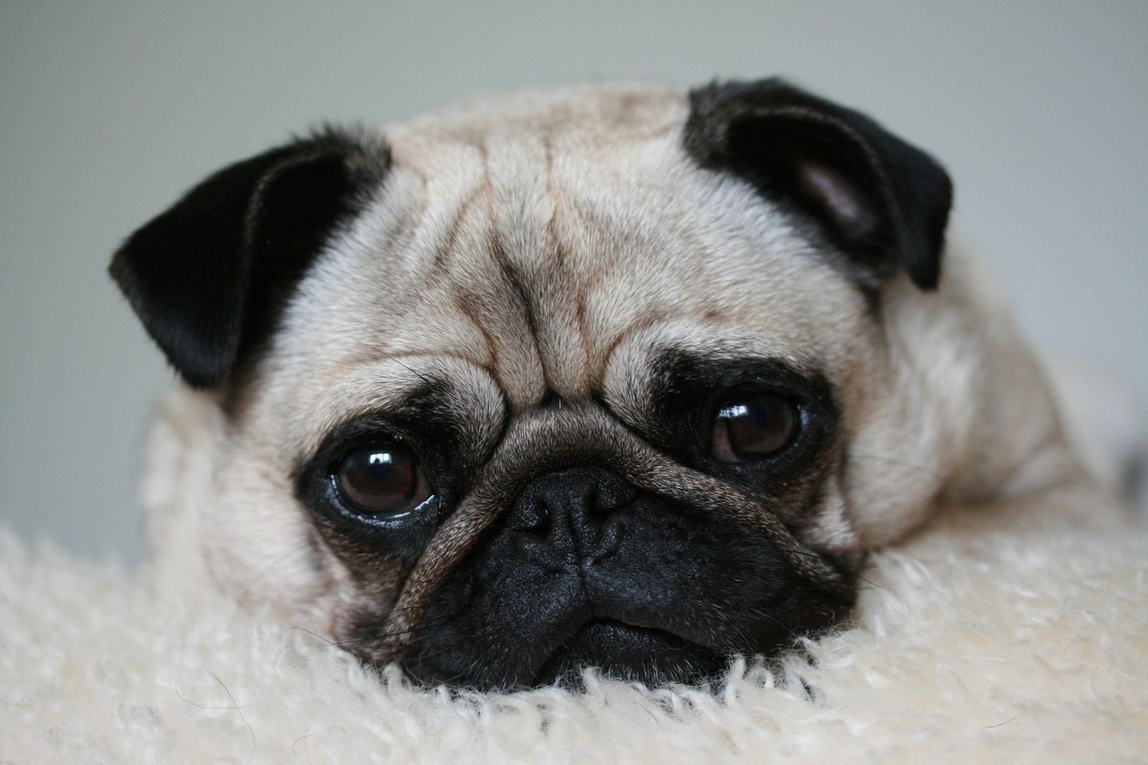

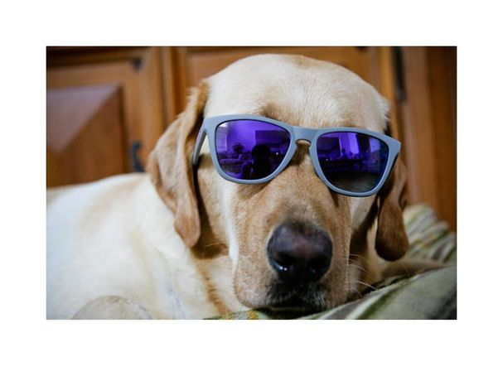
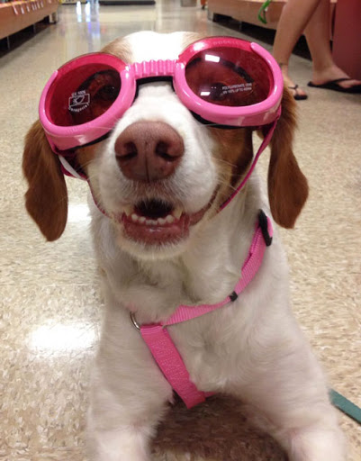
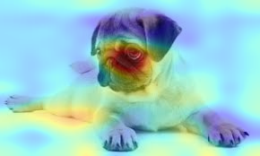
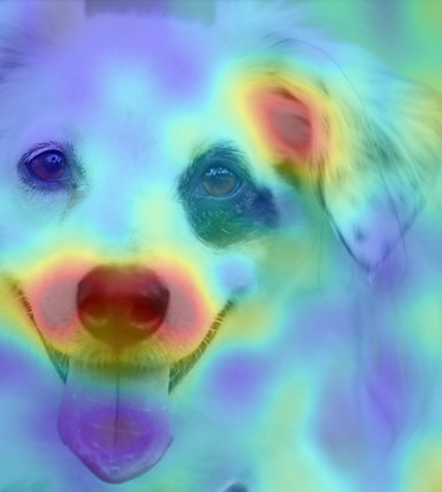
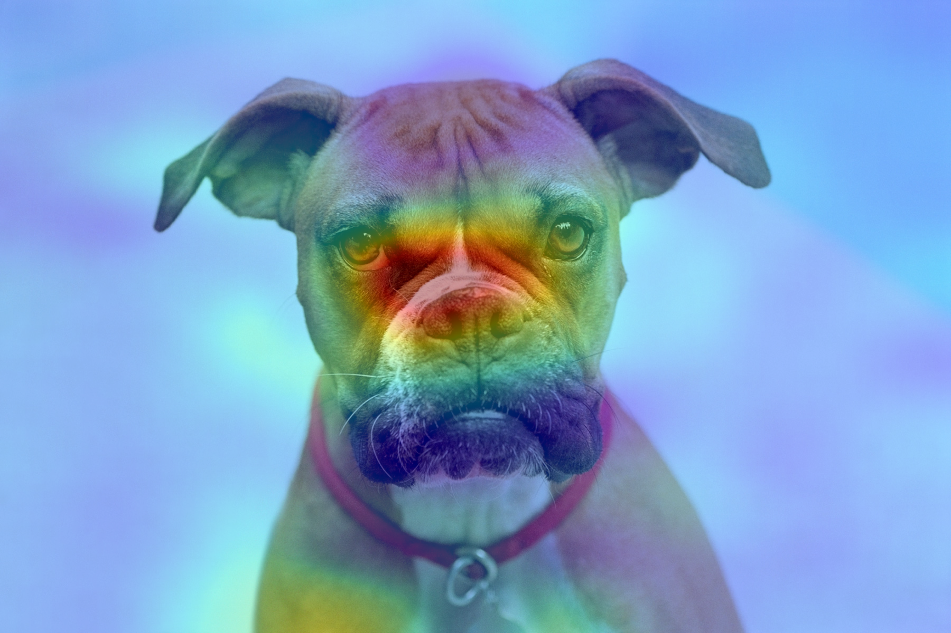
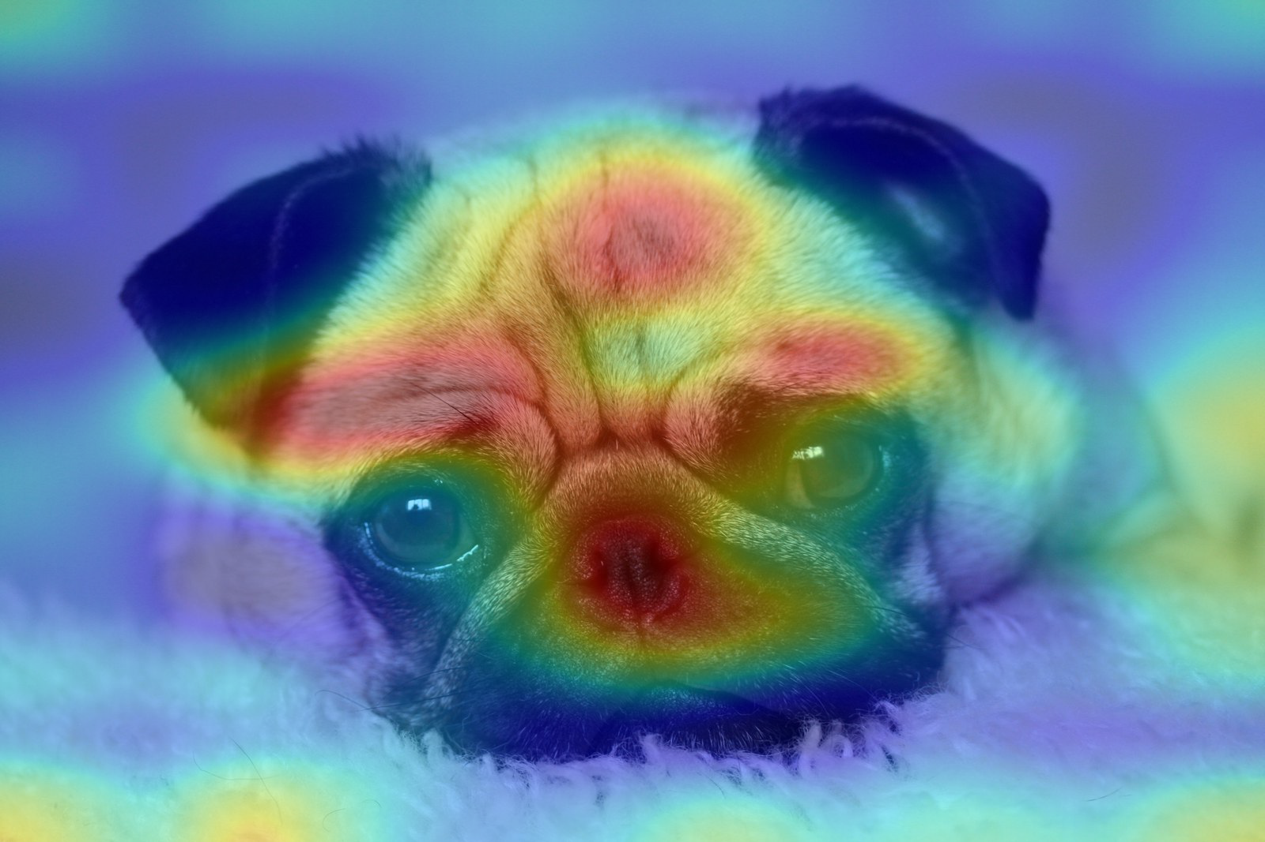
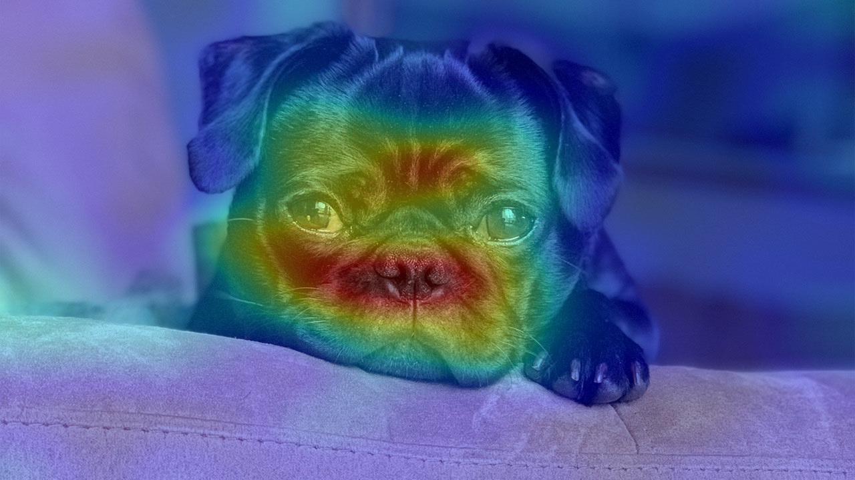
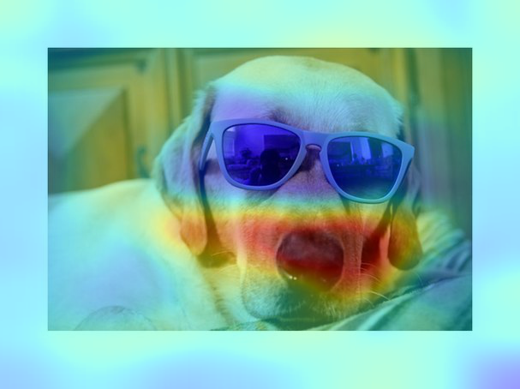
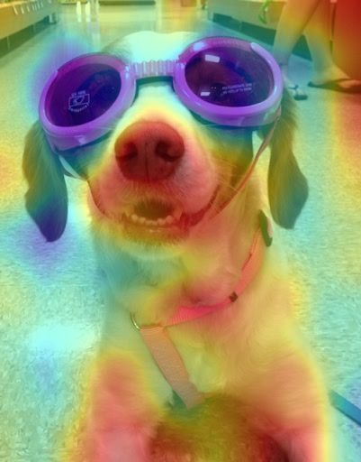
Experimental Goals
Set semantic expectancy
Extract expectancy-mismatch
Combine mismatch maps
Experimental setup
2. Implicit Saliency is greater than model saliency
Input Image
GradCam
Notes:
We now see how existing model saliency methods compare against our implicit saliency methoid. GradCam and GuidedBP represent the unsupervised model saliency methods. Model saliency finds the regions that networks used to make decisions. The images in the bottom are examples of what Grad-CAM maps look like. Our implicit saliency method can be seen as a method to find the regions where the network reexamines their decisions based on high-level semantic features. From this experiment we can see that while low-level features from GBP are important for a network to make its decision, they have relatively low correlation with human attention. Semantic features that are important for the network to make decision are correlated to human attention. This correlation can be increased by using proposed expectancy-mismatch.

Slide 46
Experimental Goals
Set semantic expectancy
Extract expectancy-mismatch
Combine mismatch maps
Experimental setup
3. Compare performance of proposed unsupervised Implicit Saliency model against existing saliency model
Training data
Saliency Models | Training data
SalGan | SALICON
ML-Net | SALICON
DeepGazeII | SALICON
ShallowDeep | SALICON/iSUN
Deep
Neural Networks
Existing Learning based methods
Notes:
We now arrive at our last experimental setup – comparison against SOTA methods.
For state-of-the-art human visual saliency detection methods, networks are trained with eye-tracking data. The overall goal of the detection model is to predict the eye-tracking data. We compare our results against SalGAN, ML-net, DeepGaze-2, and shallow deep. All these methods are trained on eye tracking data from SALICON dataset. We take the code provided by the authors and test it against MIT 1003 dataset.

Slide 47
Experimental Goals
Set semantic expectancy
Extract expectancy-mismatch
Combine mismatch maps
Experimental setup
3. Compare performance of proposed unsupervised Implicit Saliency model against existing saliency model
Training data
Saliency Models | Training data
SalGan | SALICON
ML-Net | SALICON
DeepGazeII | SALICON
ShallowDeep | SALICON/iSUN
Deep
Neural Networks
Existing Learning based methods
Proposed Implicit Saliency is unsupervised
Notes:
Our proposed implicit saliency method is unsupervised. We use pre-trained deep neural networks that have not been exposed to the eye-tracking data. The model imbues the eye-tracking data based on knowledge it obtained from training for classification or detection tasks and gets the prediction of human visual saliency. Our proposed method is able to achieve a comparable performance to supervised human visual saliency detection methods.

Slide 48
Experimental Goals
Set semantic expectancy
Extract expectancy-mismatch
Combine mismatch maps
Experimental setup
3. Compare performance of proposed unsupervised Implicit Saliency model against existing saliency model
Input Image
Groundtruth
Proposed Method
SalGan
ML-Net
DeepGazeII
ShallowDeep
Notes:
This figure shows the visualization results. Last four columns are the saliency results generated by the SOTA human visual saliency detection models.

Slide 49
Experimental Goals
Set semantic expectancy
Extract expectancy-mismatch
Combine mismatch maps
Experimental setup
3. Compare performance of proposed unsupervised Implicit Saliency model against existing saliency model
Input Image
Groundtruth
Proposed Method
SalGan
ML-Net
DeepGazeII
ShallowDeep
Comprehensive
Notes:
From this figure, Shallow and deep networks model covers a more comprehensive area

Slide 50
Experimental Goals
Set semantic expectancy
Extract expectancy-mismatch
Combine mismatch maps
Experimental setup
3. Compare performance of proposed unsupervised Implicit Saliency model against existing saliency model
Input Image
Groundtruth
Proposed Method
SalGan
ML-Net
DeepGazeII
ShallowDeep
Precise
Notes:
Salgan, ML-Net, DeepGazeII have higher precision

Slide 51
Experimental Goals
Set semantic expectancy
Extract expectancy-mismatch
Combine mismatch maps
Experimental setup
3. Compare performance of proposed unsupervised Implicit Saliency model against existing saliency model
Input Image
Groundtruth
Proposed Method
SalGan
ML-Net
DeepGazeII
ShallowDeep
Precise
Fine-grained
Comparable to supervised models
Notes:
Our proposed method is both precise and fine grained. The visualization performance is comparable to those supervised methods whose models have been exposed to eye-tracking data

Slide 52
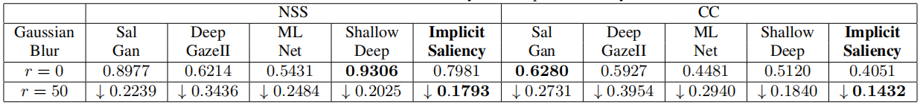
Experimental Goals
Set semantic expectancy
Extract expectancy-mismatch
Combine mismatch maps
Experimental setup
3. Compare performance of proposed unsupervised Implicit Saliency model against existing saliency model
Input Image
Groundtruth
Proposed Method
SalGan
ML-Net
DeepGazeII
ShallowDeep
Notes:
Then we look into the quantitative evaluation. The proposed model can also achieve comparable NSS and CC value withouts being exposed to eye-tracking data.

Slide 53
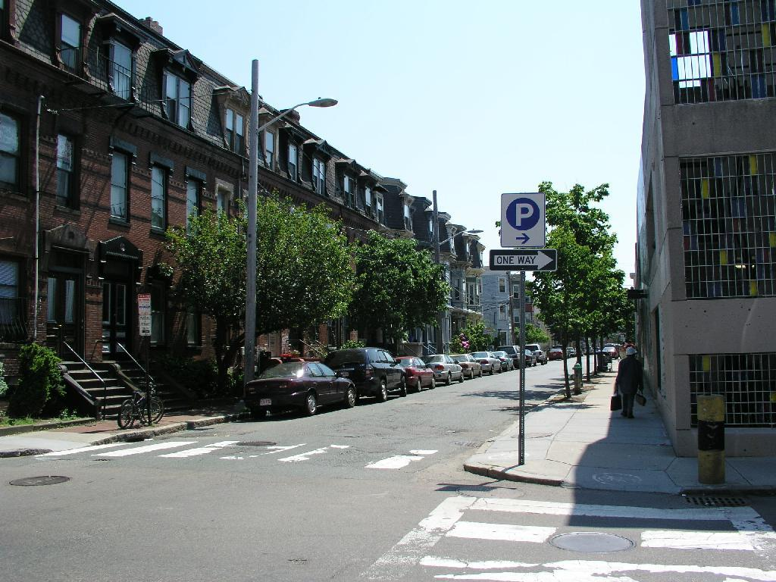
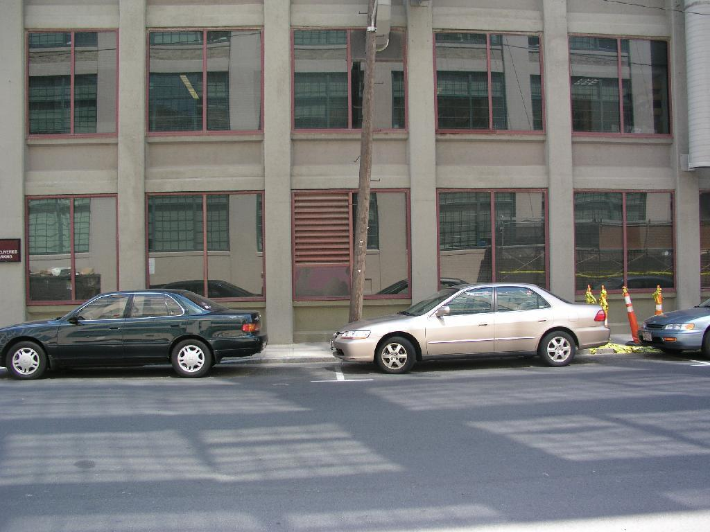
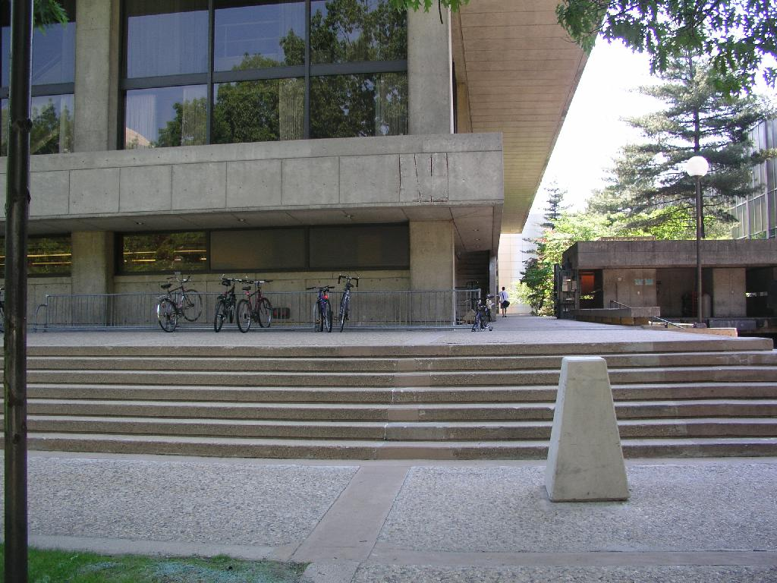
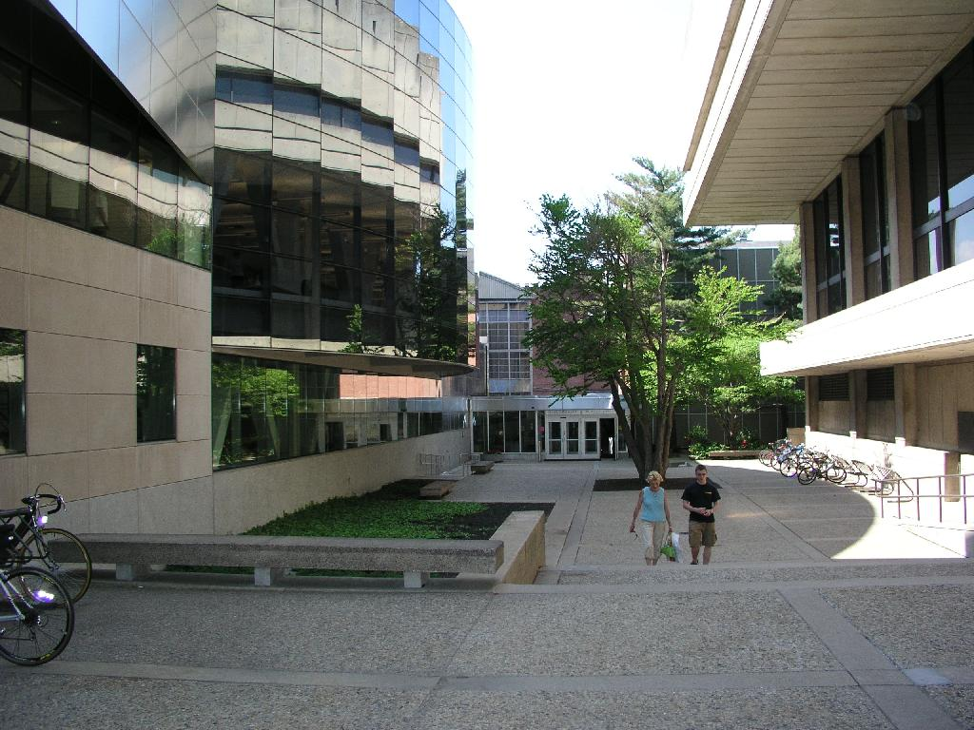
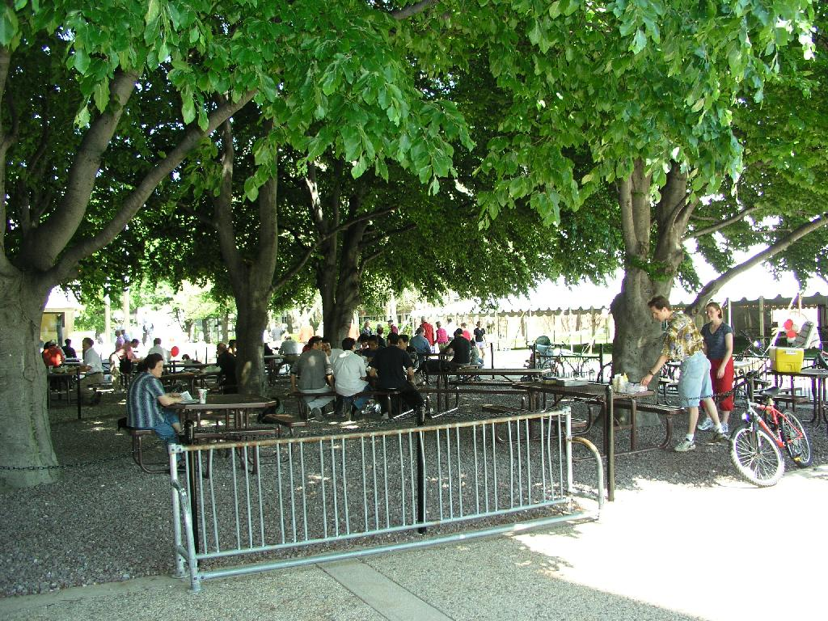
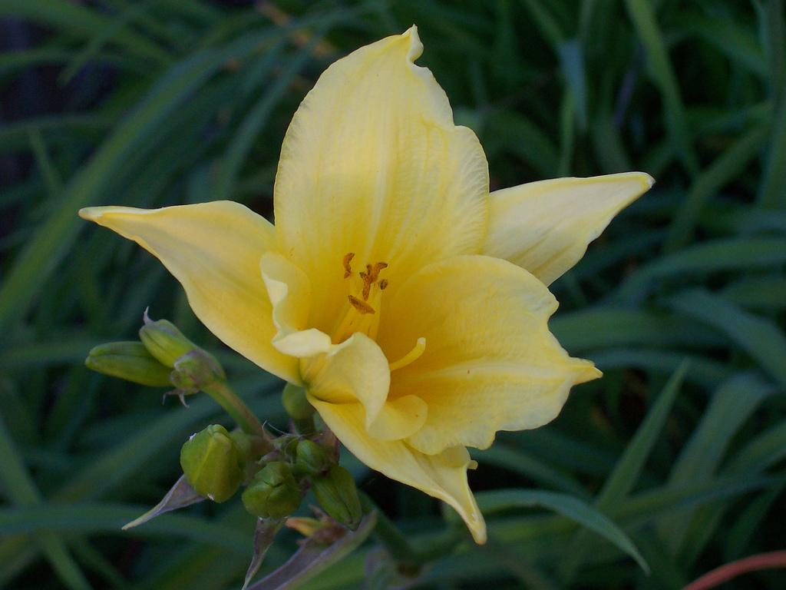
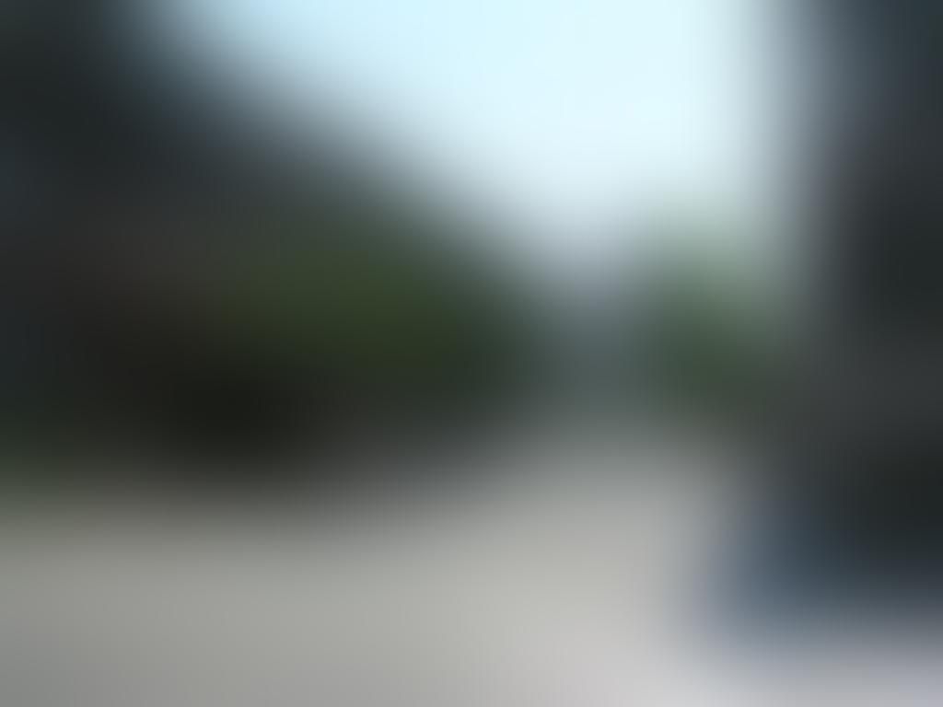






Experimental Goals
Set semantic expectancy
Extract expectancy-mismatch
Combine mismatch maps
Experimental setup
3. Compare performance of proposed unsupervised Implicit Saliency model against existing saliency model
Notes:
We then check for the robustness of methods. We add noise on top of the input to check the robustness of all considered algorithms. We add Gaussian blur with radius 50 on the top of the input image.

Slide 54
Experimental Goals
Set semantic expectancy
Extract expectancy-mismatch
Combine mismatch maps
Experimental setup
3. Compare performance of proposed unsupervised Implicit Saliency model against existing saliency model
Notes:
Even though the performance of the proposed method under zero noise condition is not the best, it drops the least with noise added, which shows that the proposed implicit saliency method is more robust.

Slide 55
Contributions
We extract implicit saliency from pre-trained networks that have not seen eye-tracking data in an unsupervised fashion.
We show that semantic features combined with expectancy-mismatch have a higher correlation with human visual saliency than low-level features or semantic features without mismatch.
We show that the proposed implicit saliency is robust to noise.
Notes:
This brings us to the final contributions of the paper. We extract implicit saliency from classification and detection networks that have never been exposed to eye-tracking data. We use expectancy mismatch in semantic features in a top down fashion to do so. We motivated the use of gradient space to span this mismatch region and provided a methodology to combine all such pseudo saliency maps to obtain an unsupervised and robust Implicit saliency detection model.

Slide 56


Thank You
Paper
Codes
Website
Paper : https://arxiv.org/abs/2008.01874
Codes : https://github.com/olivesgatech/Implicit-Saliency
Website : https://ghassanalregib.info
Notes:
Further details and codes are provided in our lab website. Please feel free to check them out. Thank you for tuning in!

